Slide 1


Slide 2
Microsoft Teams and On-Premises Mailboxes
Troubleshooting 101
Notes:
2
2

Slide 3



Thomas Stensitzki
Enterprise Consultant Granikos GmbH & Co. KG MVP Office Apps & Service MCT Regional Lead | MCSM Twitter: @Stensitzki LinkedIn: https://linkedin.com/in/thomasstensitzki
Blog DE: http://Blog.Granikos.eu Blog EN: http://JustCantGetEnough.Granikos.eu thomas.stensitzki@granikos.eu

Slide 5
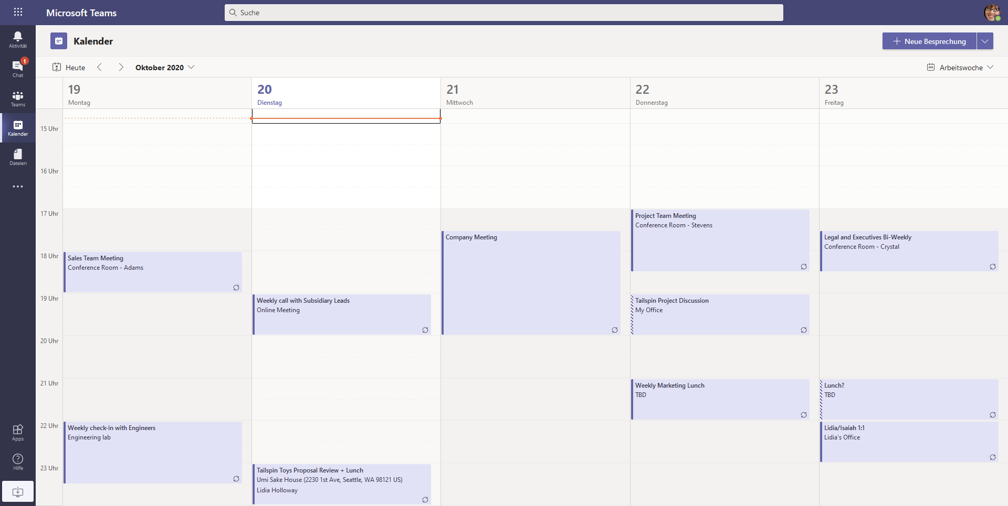
Microsoft Teams and Exchange Server

Slide 6
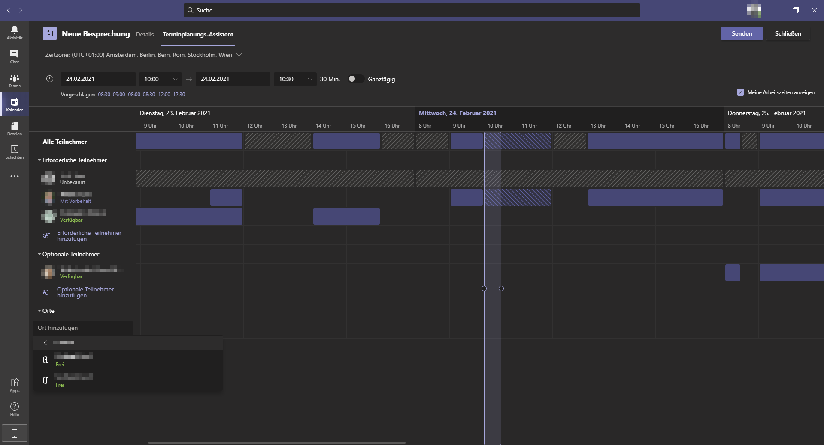
Microsoft Teams and Exchange Server

Slide 7
Microsoft Teams Calendar Access Architecture
Exchange Online
Teams Client
Teams
Calendar Middle Tier
Scheduling Service
Chat Service
Exchange On-Premises
Access to your personal calendar in your personal mailbox

Slide 8
Microsoft Teams - Architecture
Teams Clients
Web
Desktop
iOS
App
Android
App
Graph API
Services
Web
Companions
Settings and M365 access
Audio /
Video
Telemetry
Messaging
Notes
Files
Files
Other Workloads
OneNote
WAC
OneDrive for Business
SharePoint
Experimentation
Teams Backend Services
Chat & Presence Services
Calls / Meeting
AAD
MRU
Recent Files
Policy
Exchange
Calendar
Bots
PSTN
Connectors
Publish / Subscribe
Stream Recording
Graph Webhook
Push Notifications
Exchange
Search
Notification Service
Information Protection
Email Service
SMTP

Slide 9



Microsoft Teams and Exchange Server
Teams Clients
Web
Teams Backend Services
AutoDiscover
Desktop
302 HTTP
Exchange Online
iOS
App
AutoDiscover
EWS / REST
Android
App
Exchange On-Premises
Graph API

Slide 10
Microsoft Teams and Exchange Server
User account synchronization with Azure AD Connect and enabled Exchange Hybrid option
Assigned Microsoft Teams license
Exchange Server 2016 CU3 or newer
Published on-premises AutoDiscover and Exchange Web Services endpoints
OAuth configuration for Exchange Online and Exchange Server
Use Hybrid Configuration Wizard for configuration (recommended)
Manual configuration possible

Slide 11
Exchange Server
OAuth Configuration
OAuth requires the registration of Exchange Online as trusted partner application in your on-premises Exchange organization
Federation-based trust between the on-premises Exchange organization and Exchange Online
Exchange Server Authentication certificate plays an important role in the authentication process
Never delete the on-premises Auth-certificate in use
Check the configured authentication certificate with Get-AuthConfig

Slide 12
Exchange Server
OAuth Configuration
IntraOrganizationConnector defines the Discovery endpoint for SMTP domains
Exchange Online → On-premises Exchange organization all primary on-premises SMTP domains
On-premises Exchange organization → Exchange Online Service domain TENANT.mail.onmicrosoft.com
Federation trust for service endpoint Office 365 Exchange Online
There are 289 service endpoints (service principals) in Microsoft 365, 40 or Microsoft Teams alone
Connect-MsolService Get-MsolServicePrincipal | Sort-Object DisplayName | ft DisplayName,Addresses

Slide 13
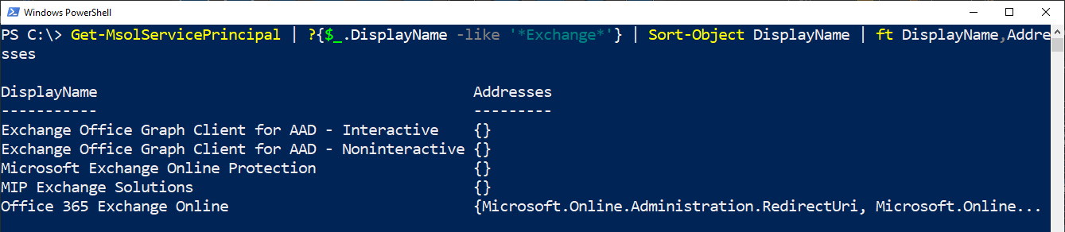
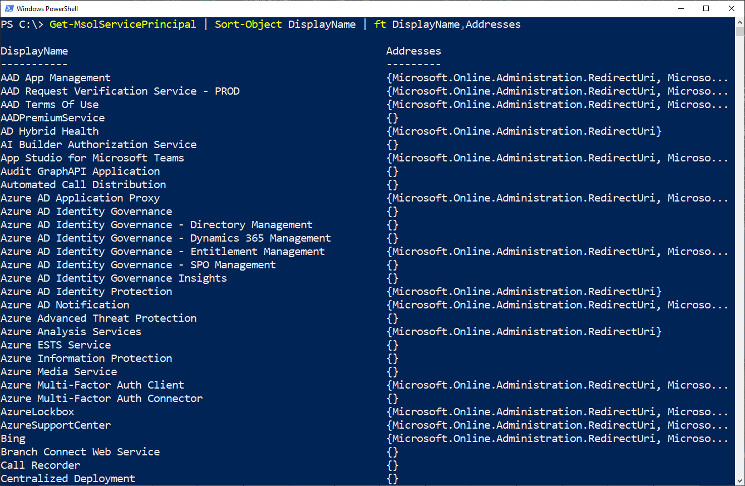
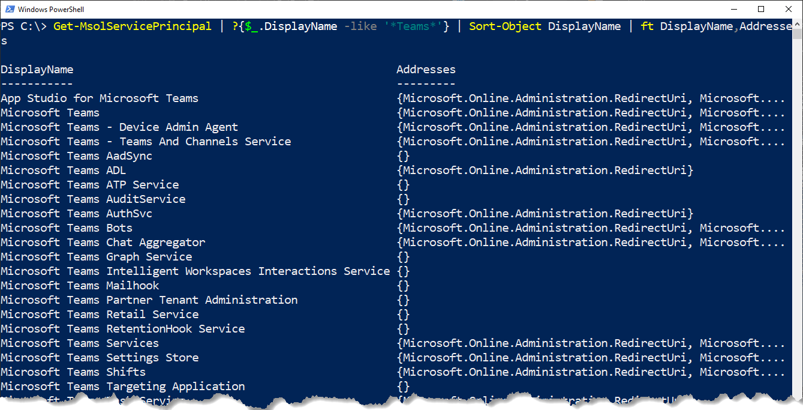
MsolServicePrincipals
Get-MsolServicePrincipal | ?{$_.DisplayName -like '*Exchange*'} | Sort-Object DisplayName | ft DisplayName,Addresses
Notes:
MSOnline PowerShell Module
Get-MsolServicePrincipal | ?{$_.DisplayName -like '*Exchange*'} | Sort-Object DisplayName | ft DisplayName,Addresses

Slide 14
Exchange Server
OAuth Configuration
Microsoft Online PowerShell → Use module MSOnline
The online documentation references the Azure AD PowerShell module
Verify MsolServicePrincipal registration
Hybrid Configuration Wizard (HCW) updates MsolServicePrincipal registration
Configure virtual directory ExternalUrl settings (MAPI, EWS, OAB) before running HCW
Configure and test external access to your on-premises Exchange organization before running HCW
→ Test Connectivity https://testconnectivity.microsoft.com/

Slide 15
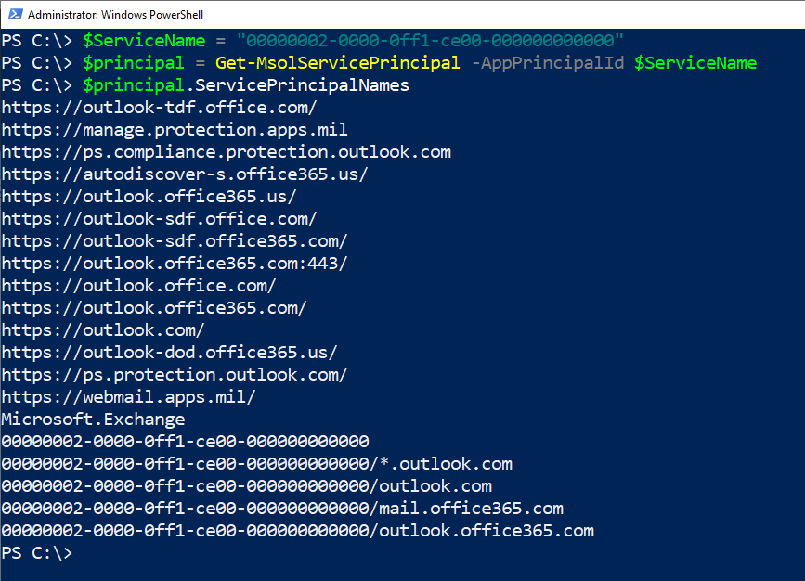
Exchange Server
OAuth Configuration

Slide 16
Exchange Server
OAuth Configuration
# Install MicrosoftOnline PowerShell module if not available # Requieres administrative PowerShell Session Install-Module -Name MSOnline # Connect to Microsoft Online tenant as Global Admin Connect-MsolService # Set Msol Service Principal Office 365 Exchange Online $ServiceName = "00000002-0000-0ff1-ce00-000000000000"
# Query Service Principal $Principal = Get-MsolServicePrincipal -AppPrincipalId $ServiceName
# Add Exchange host authorities for AutoDiscover and Exchange endpoints (-> Exchange Namespace) $Principal.ServicePrincipalnames.Add("https://mail.varunagroup.de/") $Principal.ServicePrincipalnames.Add("https://autodiscover.varunagroup.com/")
# Set new service principal configuration in your Microsoft 365 tenant Set-MSOLServicePrincipal -AppPrincipalId $ServiceName -ServicePrincipalNames ` $Principal.ServicePrincipalNames;
→ Configure OAuth authentication between Exchange and Exchange Online organizations

Slide 17
Exchange Server and Exchange Server
Enable Azure AD Connect Exchange Hybrid before using Microsoft Teams with on-premises mailboxes
Microsoft Teams uses shadow mailboxes in Exchange Online for storing compliance-relevant information
Each SMTP domain used for authentication requires its own published AutoDiscover endpoint
Teams Services do not work with HTTP 302 redirect responses
Use an Edge-Router if you cannot use a single SAN-certificate, e.g., Traeffic

Slide 18
Deep Dive

Slide 19

Microsoft Teams Backend
AutoDiscover Process
AutoDiscover for EWS and REST API endpoints
Teams Backend uses AutoDiscover v2 JSON only
→ Anonymous AutoDiscover request
Sequence
Teams Backend AutoDiscover JSON request to Exchange Online
Exchange Online checks recipient type
Mailbox → Response https://outlook.office365.com/EWS/Exchange.asmx
Mail User → Detection of DNS AutoDiscover endpoint based on users ExternalEmailAddress attribute → i.e., autodiscover.varunagroup.de
Response HTTP 302 with endpoint target URL
Teams Backend AutoDiscover JSON request to on-premises Exchange
On-premises Exchange Server responds with EWS or REST URL

Slide 20
Microsoft Teams Backend
Troubleshooting AutoDiscover
Local Teams Client Trace does not help
Anonymous AutoDiscover v2 → simple self-test
PowerShell
$email = 'AlexW@ixion-inc.de'
Invoke-RestMethod -Uri ('https://outlook.office365.com/autodiscover/autodiscover.json?Email={0}&Protocol=EWS' -f $email)
Invoke-RestMethod -Uri ('https://outlook.office365.com/autodiscover/autodiscover.json?Email={0}&Protocol=REST' -f $email)
Browser
https://outlook.office365.com/autodiscover/autodiscover.json?Email=john.doe@varunagroup.de&Protocol=EWS https://outlook.office365.com/autodiscover/autodiscover.json?Email=john.doe@varunagroup.de&Protocol=REST
Record Fiddler-Trace when executing the request

Slide 21






Exchange Server Logging
Server A
Server A
Server A, B, C, …
IIS
EWS Proxy
IIS
EWS
https.sys
MSExchangeServicesAppPool (W3WP)
https.sys
MSExchangeServicesAppPool (W3WP)
TCP 444
TCP 443
EWS
EWS
u_exXXXXXX.log
httperrXXXXX.log
HttpProxyXXXXXXXXXX-X.log
u_exXXXXXX.log
httperrXXXXX.log
EWS_XXXXXXXX-X.log
Teams Backend Services
inetpub\logs\LogFiles\W3SVC1
Logging\HTTPProxy\EWS
inetpub\logs\LogFiles\W3SVC2
Logging\EWS
Client Access Frontend
Mailbox

Slide 22
Exchange Server
Troubleshooting AutoDiscover
AutoDiscover returns unexpected EWS or REST URLs
The user has an on-premises Exchange mailbox but the response contains → https://outlook.office365.com/EWS/Exchange.asmx Most likely the use has an additional mailbox in Exchange Online → Resolve duplicate mailbox situation
The response contains an URL that looks like an internal URL → https://exch01.varunagroup.local/EWS/Exchange.asmx The EWS ExternalUrl is not configured on all Exchange Servers

Slide 23
Exchange Server
Troubleshooting AutoDiscover
AutoDiscover returns unexpected EWS or REST URLs
The user has an on-premises Exchange mailbox but the response contains → https://outlook.office365.com/EWS/Exchange.asmx Most likely the use has an additional mailbox in Exchange Online → Resolve duplicate mailbox situation
The response contains an URL that looks like an internal URL → https://exch01.varunagroup.local/EWS/Exchange.asmx The EWS ExternalUrl is not configured on all Exchange Servers

Slide 24
Exchange Server
Troubleshooting AutoDiscover
AutoDiscover returns unexpected EWS or REST URLs
The user has an on-premises mailbox in AD site EMEA but the response contains the URL of a different AD site → https://mail.apac.varunagroup.de/EWS/Exchange.asmx expected → https://mail.emea.varunagroup.de/EWS/Exchange.asmx AutoDiscover v2 was not AD site-aware → Update to a supported Exchange Server Cumulative Update

Slide 25
Microsoft Teams Backend
Calendar-App Process
Teams Backend Services query calendar information using Exchange Web Services
Sequence
Retrieve EWS URL as part of an AutoDiscover v2 request
Teams Backend Services authenticate to on-premises Exchange using OAuth
Teams Backend Services send EWS calendar request to Exchange Web Services
On-premises Exchange replies with calendar data
Teams Middle-Tier transfers data to calendar app for further usage

Slide 26
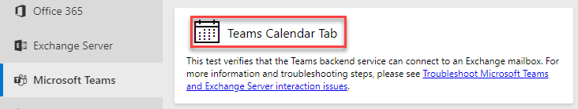
Exchange Server
Troubleshooting Calendar App
Does the external DNS zone resolve the EWS host name and is the endpoint accessible?
Use Fiddler → Open EWS URL in a browser, you must receive a HTTP 401 response → Ensure that you are not connected to the company network
Use the Test Connectivity test
Verify OAuth configuration
Test-OAuthConnectivity cmdlet
Verify SPNs, IntraOrganizationConnector and AuthServer settings

Slide 27

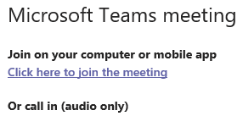
Microsoft Teams and Calendar Delegation
Delegate Access Process
Create a new Teams meeting from within the manager's calendar
Teams uses EWS to query delegate information and permission
You must use the Outlook delegate wizard for configuration
Sequence
Delegate clicks „New Teams Meeting”in manager's Outlook calendar
Teams-AddIn connects to Teams Middle-Tier
Middle-Tier determines EWS URL using AutoDiscover V2
Teams Services connect and authenticate to on-premises /EWS vDIR using OAuth
Teams Services send a GetDelegate SOAP request for the Teams meeting to the manager's mailbox
Exchange Server responses with a delegate list and permissions
Teams Middle-Tier returns meeting information to AddIn

Slide 28
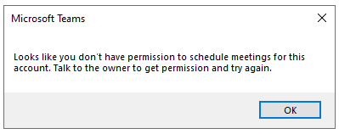
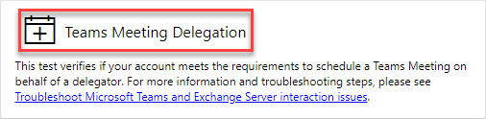
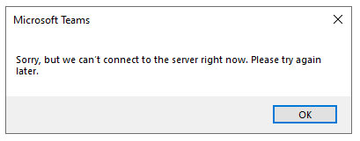
Microsoft Teams and Calendar Delegation
Troubleshooting Calendar Delegation
Does the calendar app itself work correctly for the manager and delegate?
Run a manual GetDelegate query with SOAPe client
Do a Fiddler trace → Status code 403
Use the Test Connectivity Test
Calendar folder permission is not sufficient!
Verify EWS log files for GetDelegate request
Verify the PartnerApp configuration
Verify EWS Proxy and IIS FrontEnd log files
Do a network trace
Eliminate Layer 7 network devices → User Agent filtering

Slide 29
Microsoft Teams and Calendar-Based Presence
Automatic presence status „In a meeting”
Teams Services use REST API
Teams Client queries Presence Service every six minutes
Two different mode options
Pull-Mode → 1x per hour
Push-Mode → Subscription-based
With on-premises Exchange Server you have Pull-Mode only

Slide 30
Microsoft Teams and Calendar-Based Presence
Presence Process
Sequence
Middle-Tier determines REST URL using AutoDiscover V2
Teams Services connect and authenticate to on-premises /api vDIR with OAuth
Teams Services try to create a subscription and fail → Error: RPC endpoint not found
Teams Services send a calendar query (Pull Mode)

Slide 31
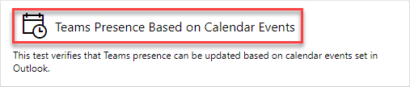
Microsoft Teams and Calendar-Based Presence
Presence Troubleshooting
Does the AutoDiscover response contain the /API URL and is the endpoint accessible from the Internet?
Do a Fiddler-Trace
Use Test Connectivity Test
Update REST CAFE web.config if still on pre-December 2020 CU
Verify REST protocol log files
Verify REST Proxy and IIS FrontEnd protocol log files
Eliminate Layer 7 network devices → User Agent filtering

Slide 32
Microsoft Teams and Calendar-Based Presence
Presence Troubleshooting
Update REST CAFE web.config if still on pre-December 2020 CU
C:\Program Files\Microsoft\Exchange Server\V15\FrontEnd\HttpProxy\Rest\web.config
FROM: <httpRuntime maxRequestLength="2097151" maxUrlLength="2048" requestPathInvalidCharacters="&lt;,>,*,%,\,?" requestValidationMode="2.0" />
TO: <httpRuntime maxRequestLength="2097151" maxUrlLength="2048" maxQueryStringLength="4096" requestPathInvalidCharacters="&lt;,>,*,%,\,?" requestValidationMode="2.0" />

Slide 33
Microsoft Teams Client Protocols
Local protocol files
%APPDATA% \Microsoft\Teams\logs.txt
%APPDATA%\Microsoft\Teams\media-Stack
%APPDATA%\Microsoft\Teams\skylib
MS Teams diagnostic protocols (desktop / web client)
Strg + Alt + Shift + 1
Protocol files are saved to Downloads folder

Slide 34
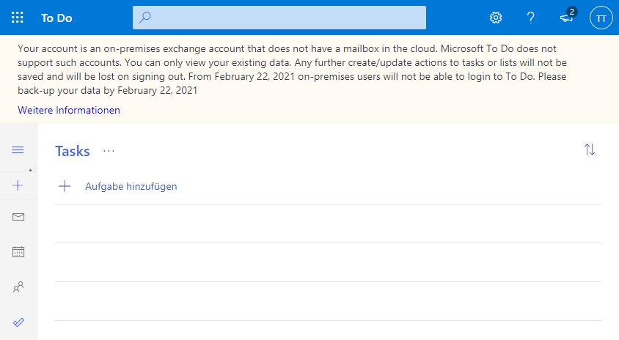
Microsoft Teams and Exchange Server
Constrains
No access to other personal calendar folders in your mailbox
No usage of To Do or Bookings with an on-premises mailbox

Slide 35
Questions?
Slides by www.SUBTITLE.com
Notes:
35
35

Slide 36
Thomas Stensitzki
Enterprise Consultant Granikos GmbH & Co. KG MVP Office Apps & Service MCT Regional Lead | MCSM Twitter: @Stensitzki LinkedIn: https://linkedin.com/in/thomasstensitzki
Blog DE: http://Blog.Granikos.eu Blog EN: http://JustCantGetEnough.Granikos.eu thomas.stensitzki@granikos.eu

Slide 37
Thank You!
Slides by www.SUBTITLE.com
Notes:
37
37

Slide 38
Ressources
Create a hybrid deployment with the Hybrid Configuration wizard
Requirements to create and view meetings for mailboxes hosted on-premises
Use log files to monitor and troubleshoot Microsoft Teams
SOAPe-Client
My user has a mailbox both on-premises and in Exchange Online. Help!

